Slide 1

Chapter 1: Introduction to Security
Gonzalo De La Torre Parra, Ph.D.
Fall 2021

Slide 2
Objectives
Explain the challenges of securing information
Define information security and explain why it is important
Identify the types of threat actors that are common today
Describe how to defend against attacks

Slide 3
1.1 Challenges of Securing Information
Tens of billions of dollars are spent annually on computer security yet, the number of successful attacks continues to increase.
Cyber Security Events:
Remote control of a Jeep Cherokee
Probing aircraft systems while in flight (United airlines)
500 million compromised accounts (Yahoo)
Rubber duckies (USB Flash drives containing malware)
Lock down its administrator account and wireless network settings on voting machines (WinVote)

Slide 4
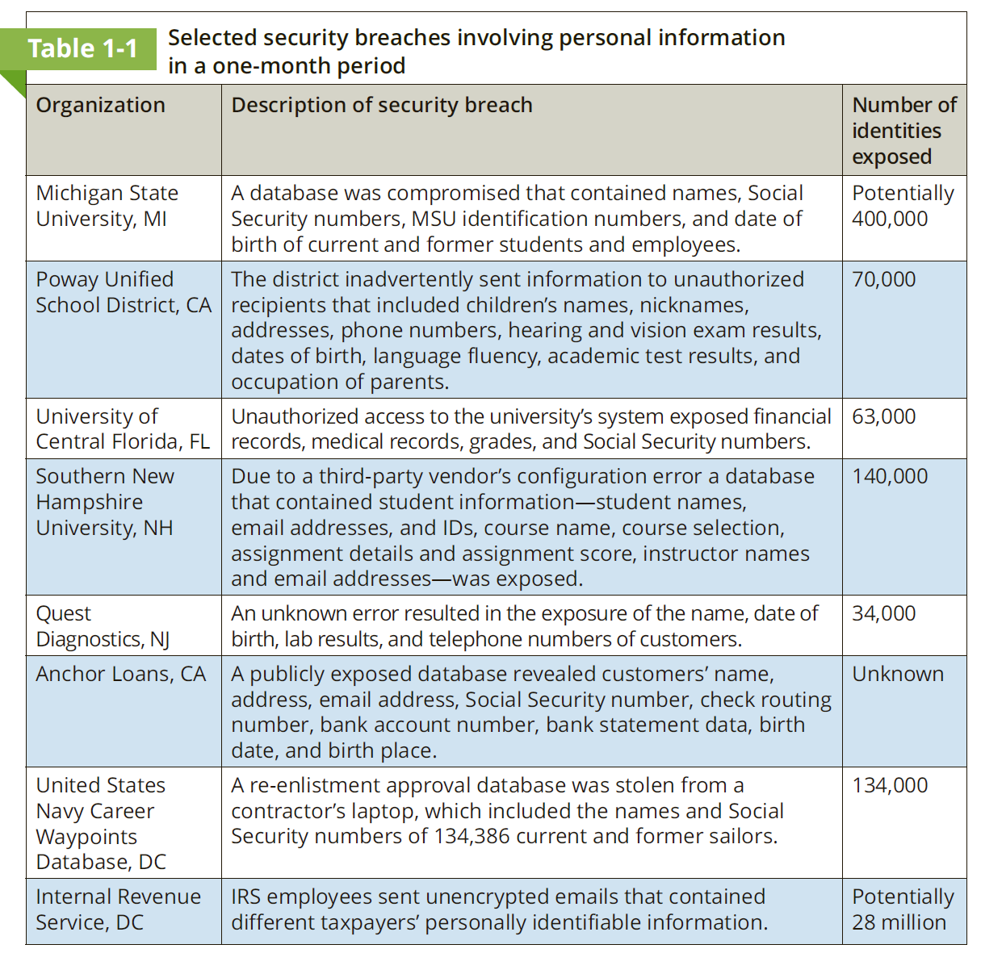
1.1 Breaches on Personal Information

Slide 5
Why are these attack successful?
Widespread vulnerabilities
Configuration issues
Poorly designed software
Hardware limitations
Enterprise-based issues

Slide 6
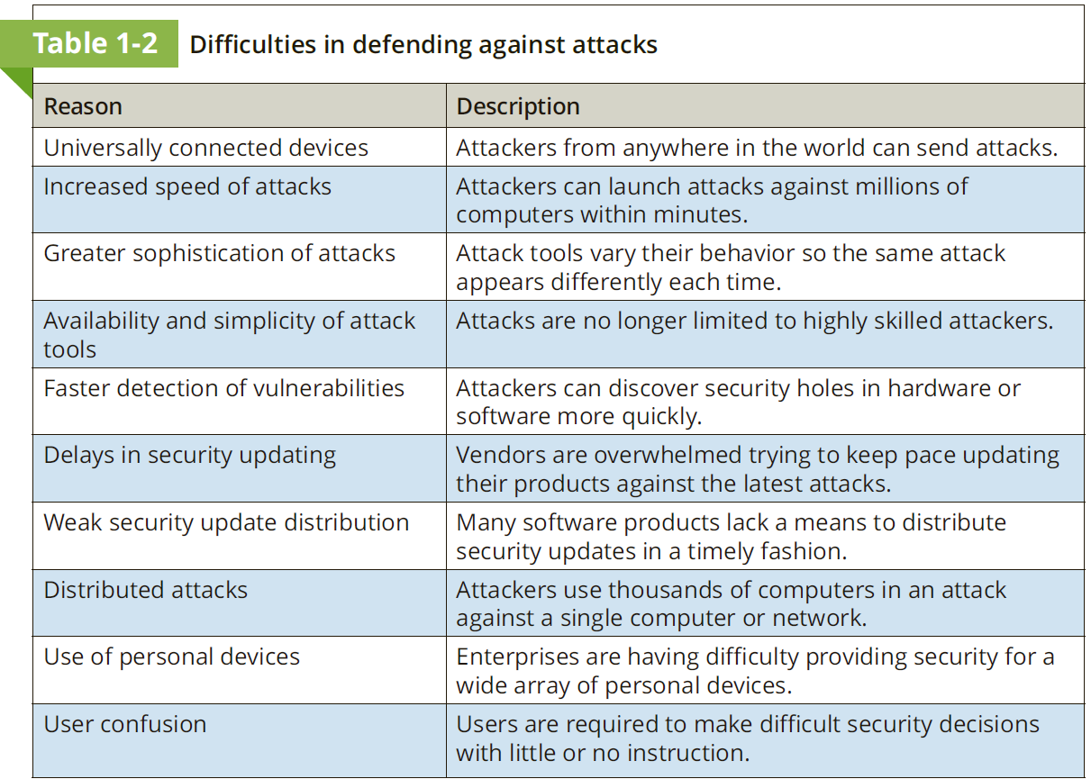

Slide 7
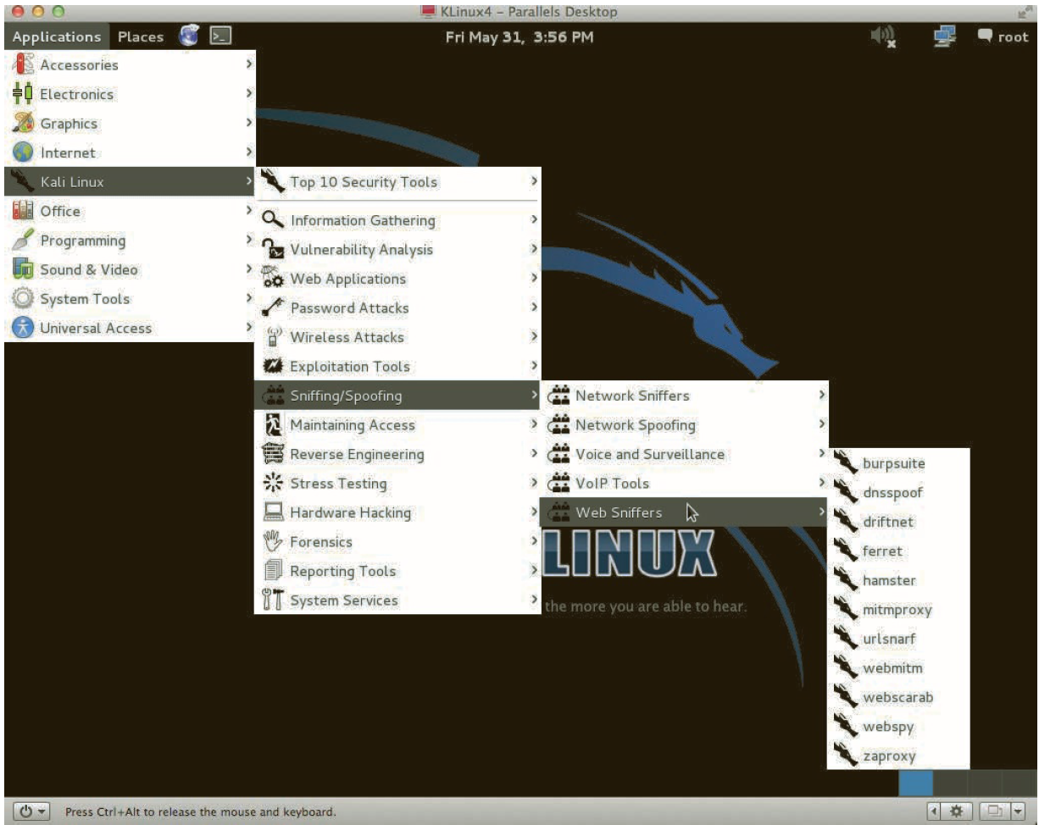
E.g. Kali Linux

Slide 8
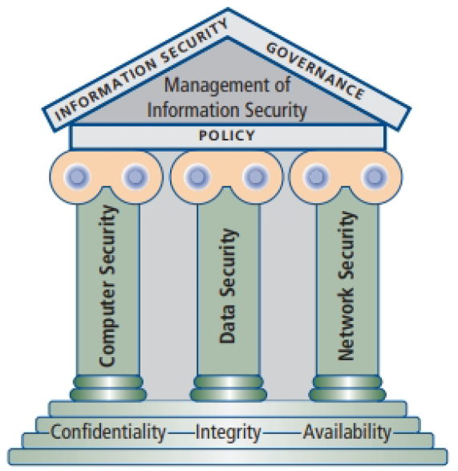
Understanding Security and Information Security
Security:
The measures taken to ensure safety
The necessary steps to protect from harm
Information Security
Ensure that protective measures are properly implemented to ward off attacks and prevent the total collapse of the system when a successful attack does occur
Protect information that provides value to people and enterprises

Slide 9
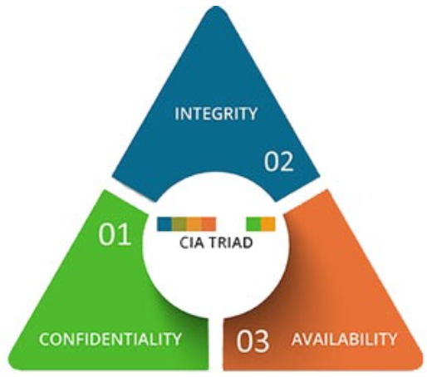
CIA Triad
CIA: Three protections that must be extended over information
Information security revolves around the three key principles: confidentiality, integrity and availability (CIA).
Key characteristics of information that make it valuable to an organization

Slide 10
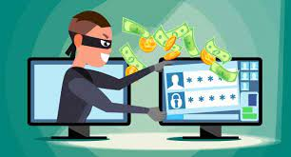
What is Confidentiality?
Confidentiality measures are designed to protect against unauthorized disclosure of information. The objective of the confidentiality principle is to ensure that private information remains private and that it can only be viewed or accessed by individuals who need that information in order to complete their job duties.

Slide 11
What is Confidentiality?
While U.S. federal agencies have had lapses that resulted in unwanted data disclosures, an event in July 2015 eclipsed all previous similar lapses.
The loss of 21.5 million federal background-check files rocked the Office of Personnel Management (OPM)
Revealing names, addresses, financial records, health data, and other sensitive private information
Chinese hackers (Believed to be responsible)

Slide 12
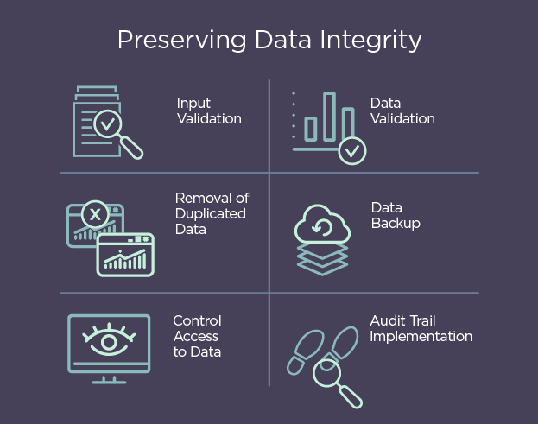
What is Integrity?
Integrity involves protection from unauthorized modifications (e.g., add, delete, or change) of data. The principle of integrity is designed to ensure that data can be trusted to be accurate and that it has not been inappropriately modified.

Slide 13
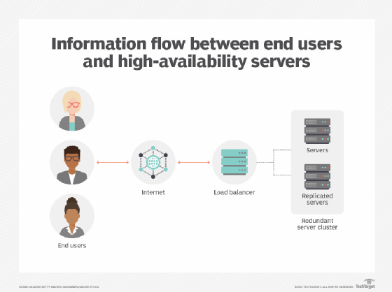
What is availability?
Availability is protecting the functionality of support systems and ensuring data is fully available at the point in time (or period requirements) when it is needed by its users. The objective of availability is to ensure that data is available to be used when it is needed to make decisions.

Slide 14
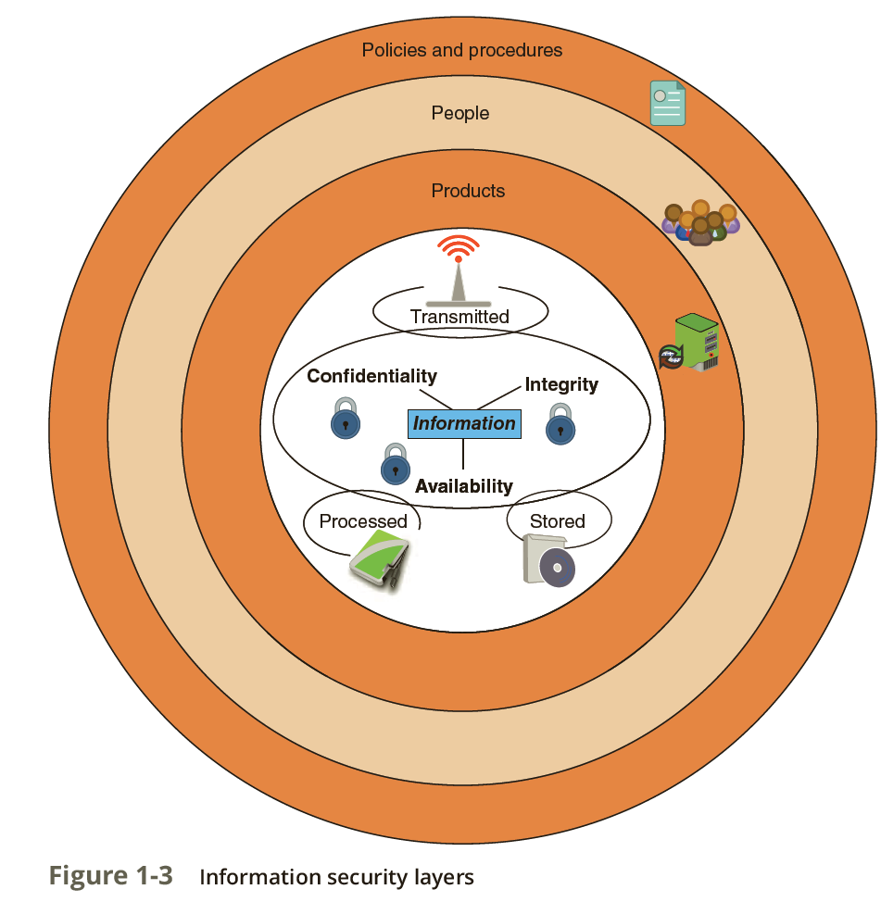
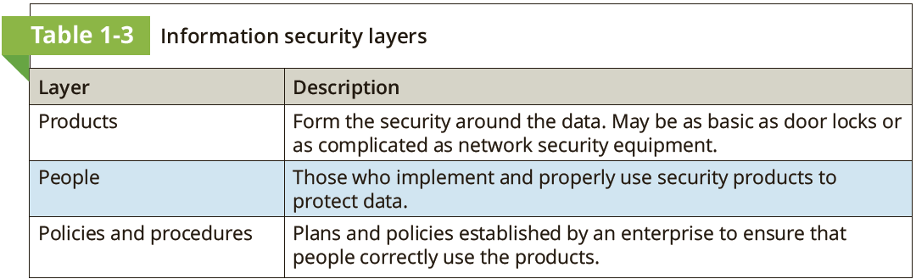
Information Security Layers

Slide 15
Information Security Components Analogy
Suppose that Ellie wants to purchase a new motorized Italian scooter to ride from her apartment to school and work. However, because several scooters have been stolen near her apartment she is concerned about its protection. Although she parks the scooter in the gated parking lot in front of her apartment, a hole in the fence surrounding the apartment complex makes it possible for someone to access the parking lot without restriction.
Which is the asset?
What is the vulnerability?
What is the attack vector?
What is the threat?
Who is the threat actor?
What is the risk?

Slide 16
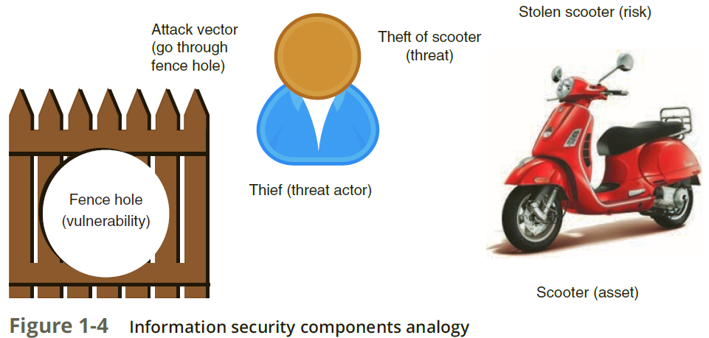
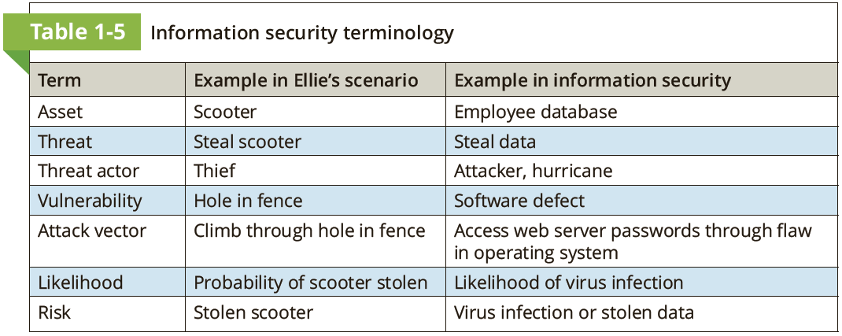
Information Security Components Analogy
Which is the asset?
What is the vulnerability?
What is the attack vector?
What is the threat?
Who is the threat actor?
What is the risk?

Slide 17
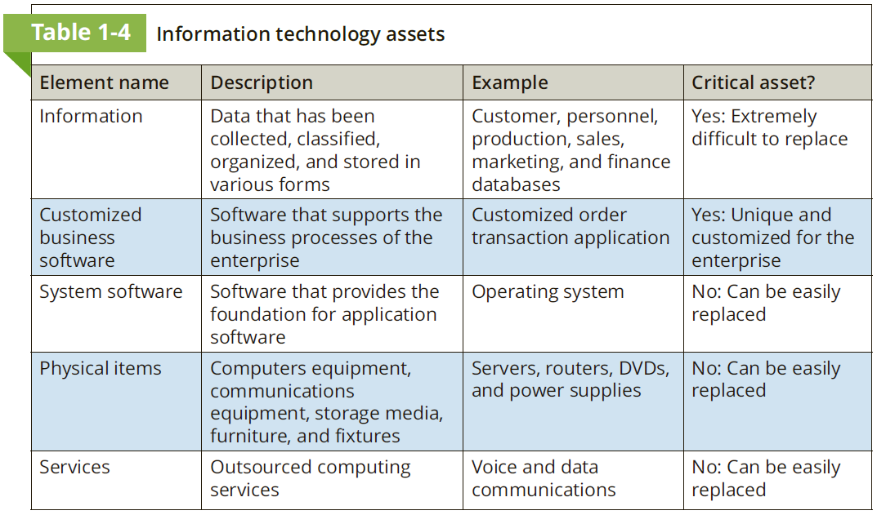
Should everything be considered an asset?

Slide 18
Risk response techniques
Accept
Transfer
Avoid
Mitigate

Slide 19
Risk response techniques
Accept: Risk acknowledgement – no steps are taken to address it
Transfer: Pass the risk to a third party (E.g., Insurance)
Avoid: Not acquiring the asset
Mitigate: Address the risk

Slide 20
Importance of Information Security
Preventing data theft
Thwarting Identity Theft
Avoiding Legal Consequences (Data Protection Federal and State Laws)
The Health Insurance Portability and Accountability Act of 1996 (HIPAA)
The Sarbanes-Oxley Act of 2002 (Sarbox)
The Gramm-Leach-Bliley Act (GLBA)
Payment Card Industry Data Security Standard (PCI DSS)
State notification and security laws

Slide 21
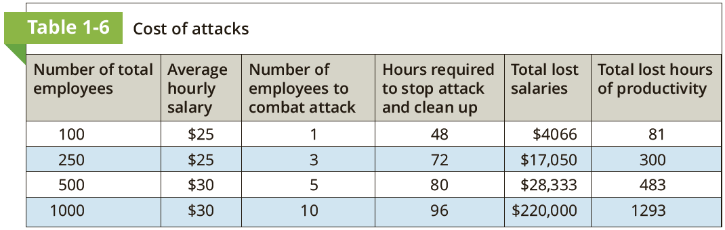
Maintaining Productivity
Cleaning up after an attack diverts time, money, and other resources away from normal activities.

Slide 22
Cyberterrorism
The FBI defines cyberterrorism as any “premeditated, politically motivated attack against information, computer systems, computer programs, and data which results in violence against noncombatant targets by subnational groups or clandestine agents.”
Objective
Cause panic or provoke violence among citizens

Slide 23
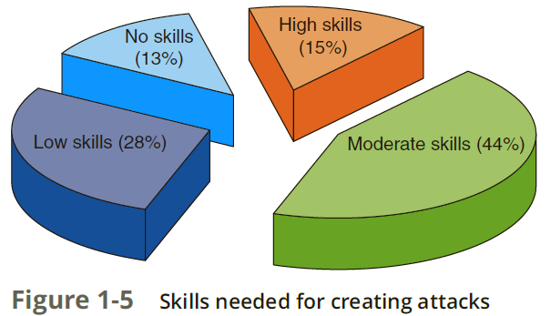
Threat Actor
Threat actor is a generic term used to describe individuals who launch attacks against other users and their computers (another generic word is simply attackers).
Script Kiddies
Hacktivists
Nation State Actors
Insiders
Competitors
Organized crime
Brokers
Cyberterrorists

Slide 24
Fundamental Security Principles
Layering: A layered security approach, also called defense-in-depth, can be useful in resisting a variety of attacks. If only one defense mechanism is in place, an attacker only has to circumvent that single defense.
Limiting: Limiting access to information reduces the threat against it. This means that only those personnel who must use the data should have access to it.
Diversity: Multiple types of security mechanisms (E.g., Access control, technical controls, administrative controls, etc.)
Obscurity: Not revealing the type of computer, version of operating system, or brand of software that is used.
Simplicity: As much as possible, a secure system should be simple for those on the inside to understand and use. Yet, it should be complex from the outside.

Slide 25
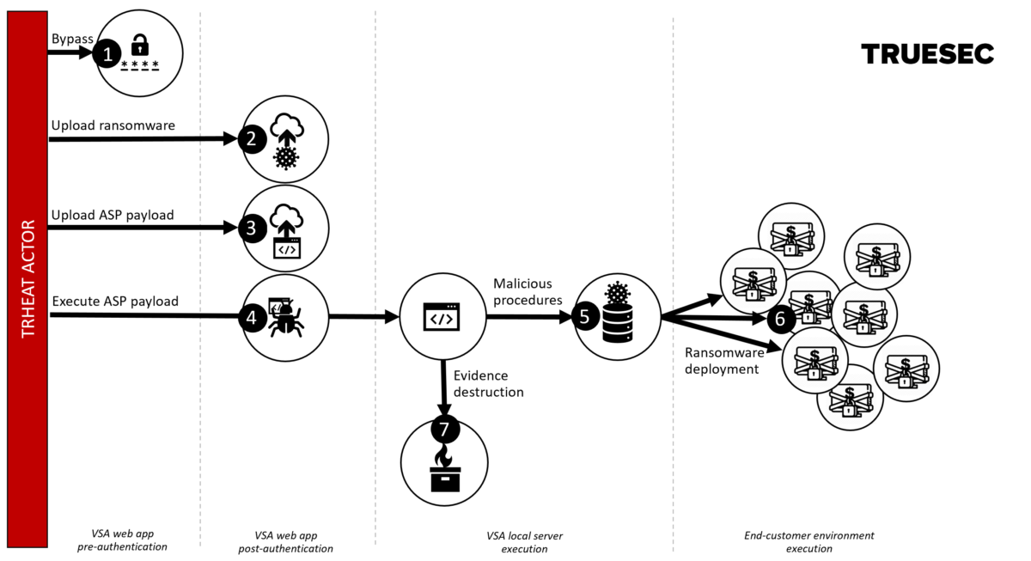
Kaseya Attack Timeline
https://blog.truesec.com/2021/07/06/kaseya-vsa-zero-day-exploit/

